Slide 1

Predicting Airbnb user's desired travel destinations

Slide 2
Machine learning
Machine learning applications today are largely used by companies like Google to enhance the user experience when using their products, for example in the process of identifying and classifying emails as spam. Another application is making sure that advertisements reach users who are most likely interested in what is being advertised. If we have enough data we can make very precise predictions.

Slide 3
MACHINE LEARNING
Supervised: is where we give the computer a set of data with every correct outcome listed and we have the computer find patterns to why the data produces a certain outcome.
Unsupervised: is where we give the computer some data but no correct solution is presented to it and it’s up to the computer to generate a solution by for example splitting the data into groups based on similar properties.
Reinforced learning: is when the computer learns by trial and error, every solution the computer presents is tested and awarded with positive or negative feedback which the computer then uses to further improve on its solution.

Slide 4
PROBLEM
The problem is how we create a model for predicting user intentions based on user data such as the personal information they entered themselves when creating an account or data collected by the site on what users did during their time on the site. The challenge is to predict and rank the 5 most likely travel destinations of every user.

Slide 5
ANALYSING THE DATA
There are 5 datasets supplied by Airbnb for the competition to help us with the prediction:
Train_users_2: The data points in this field contains data gathered from the first recorded visit of the user and the data entered during his/her signup process. For the training set we also have data on which country the user first chose to travel to.
Test users: contains users on which the prediction is supposed to be made, it uses the same format as Train_users with the exception of the date_first_booking and country_destination fields.
Sessions: Contains records of user’s actions on the website. Each record in this dataset contains data on what action was performed with what device type and the time spent.
Age_gender_bkts: This dataset groups users in the training set into age groups of 5 years difference and shows information about each group’s gender and decided country destination.
Countries: A summary of the different country destinations and various data on their location and which language is primarily spoken there

Slide 6
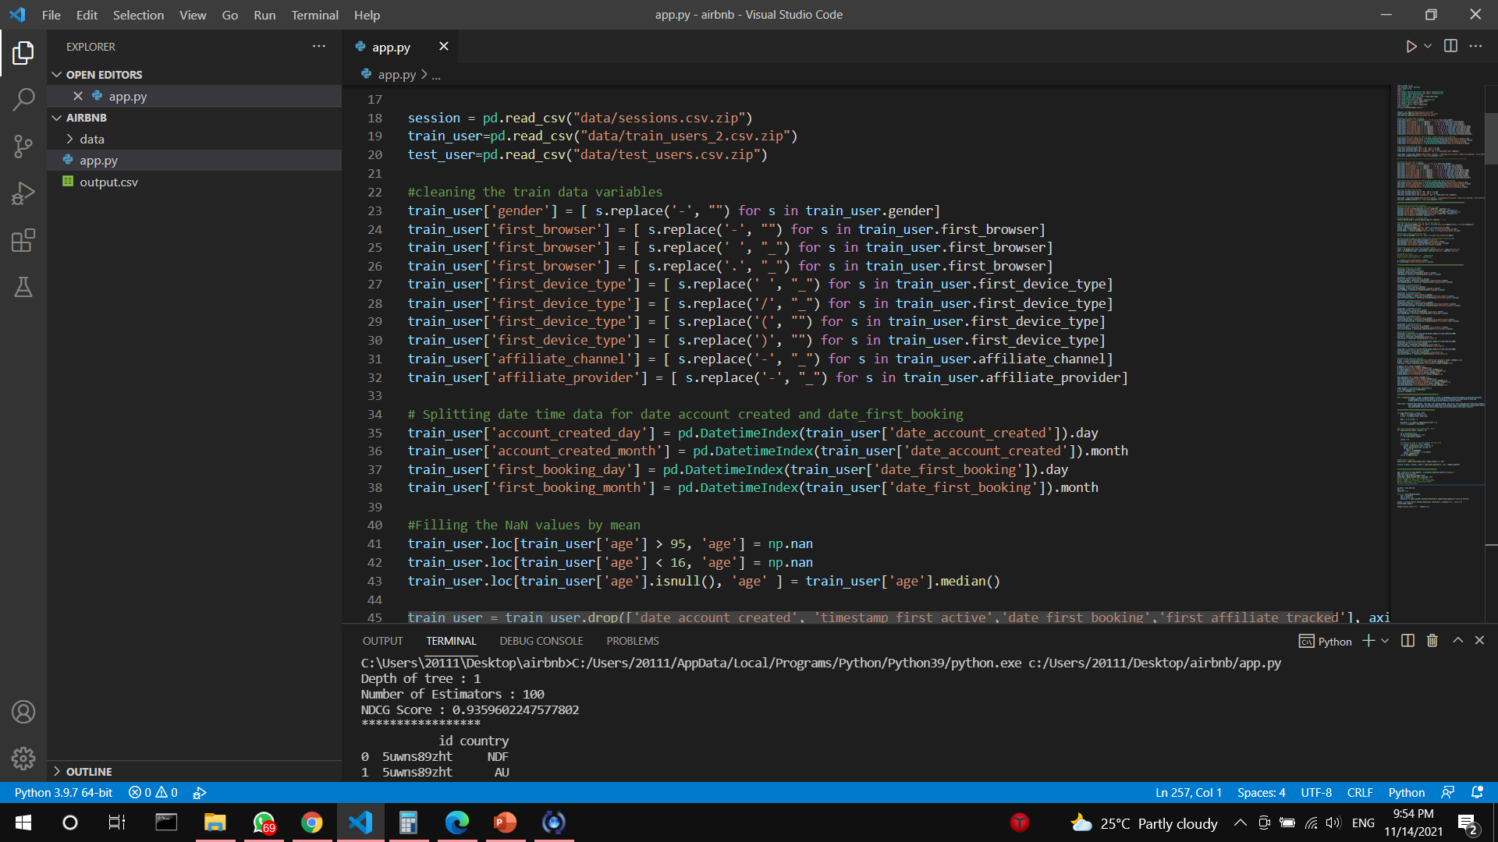
CLEANING THE DATASETS
Replacing spaces with ‘_’ and removing undesired dots, slashes and brackets.

Slide 7
CLEANING THE DATASETS
Removing ages which are more than 95 or less than 15 and instead putting the median age value

Slide 8
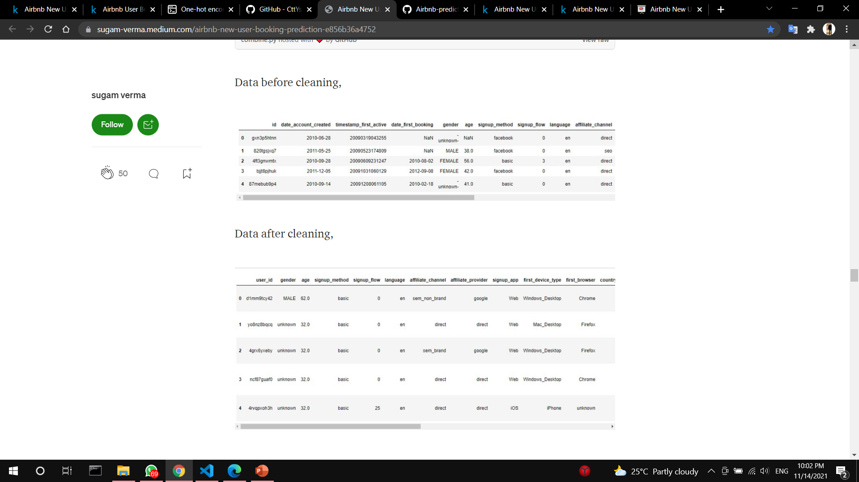
Data before and after cleaning

Slide 9
XGBOOST ALGORITHM
The algorithm is an implementation of gradient boosted decision trees.
Datasets today become larger which pose a problem for the existing hardware where for instance the memory is very limited which requires good memory handling from the machine learning algorithms to not suffer too much from common out of memory issues. XGBoost uses several different techniques to tackle these problems.

Slide 10
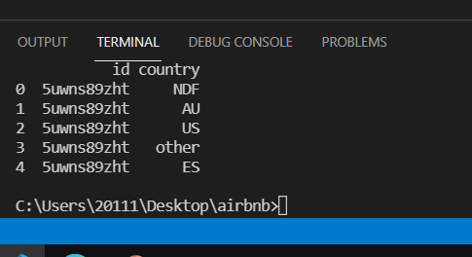
The output

